Slide 1
Dipartimento Lingue Straniere
Lingua e civiltà Inglese

Slide 2
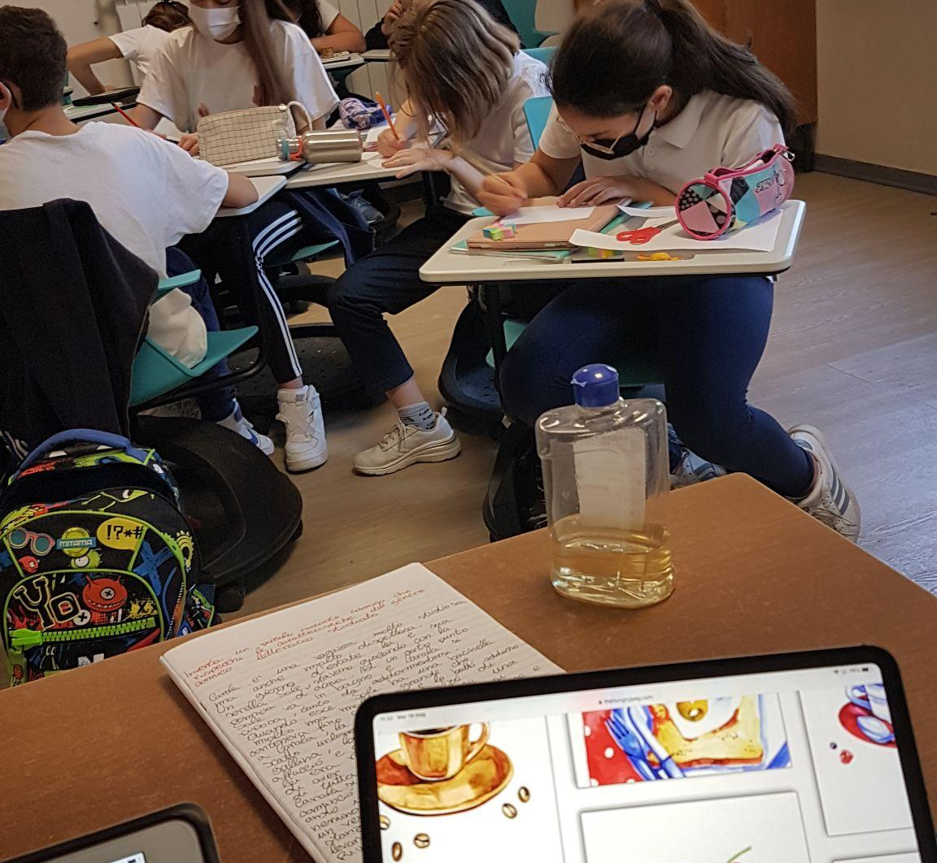
We use modern technology

Slide 3
ON LINE CLASSROOMS …

Slide 4
SMART BOOKS …

Slide 5
… AND ON LINE REGISTER «ARGO»

Slide 6
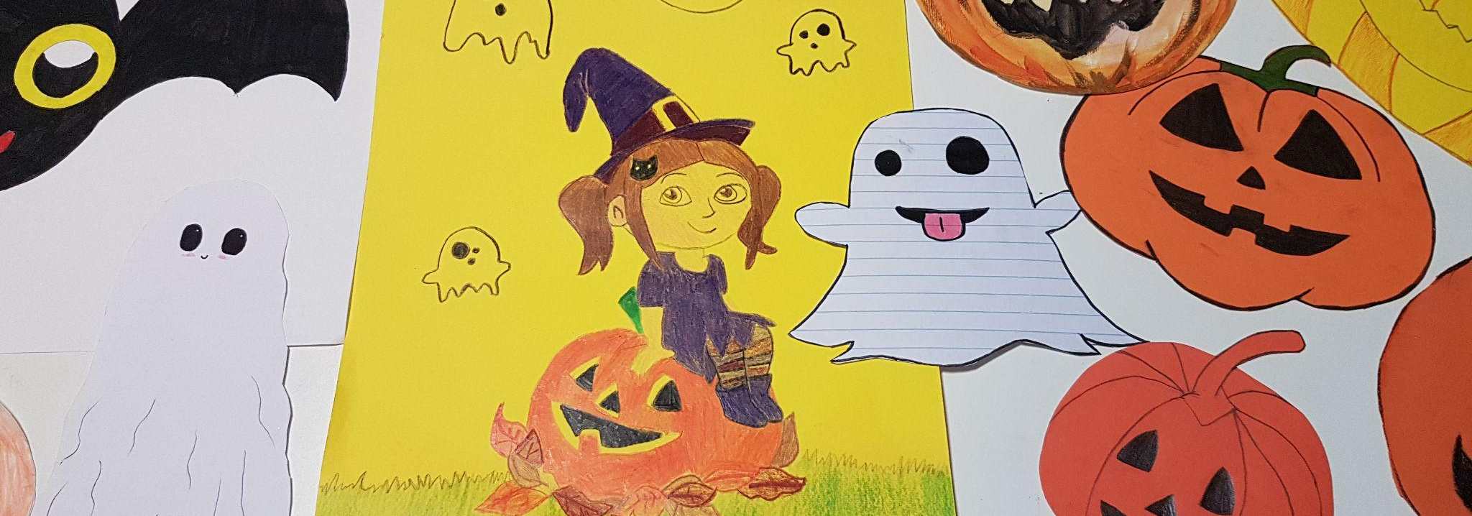
We enjoy other customs

Slide 7
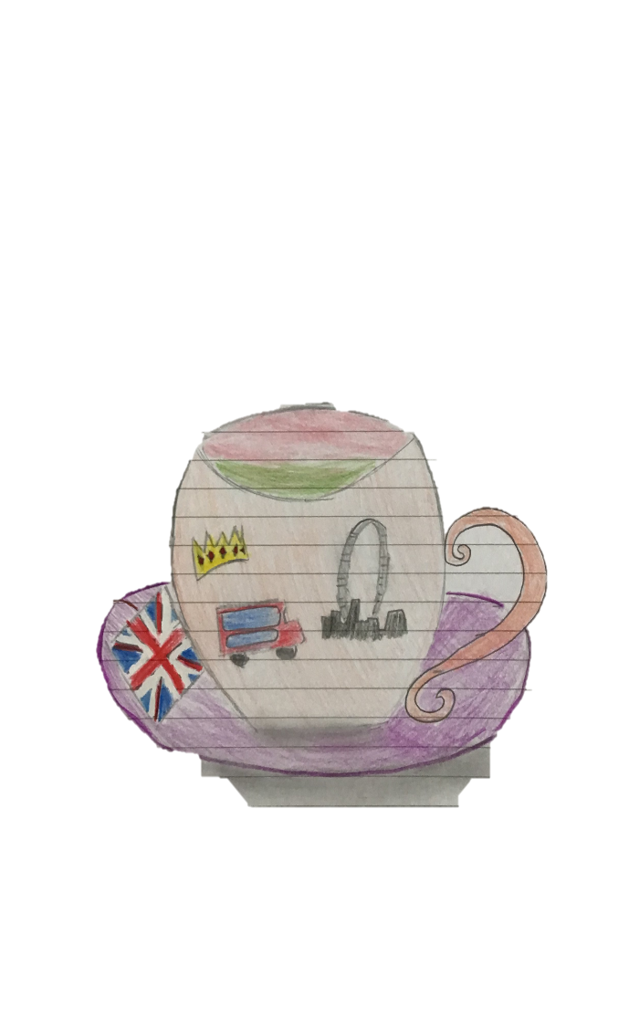
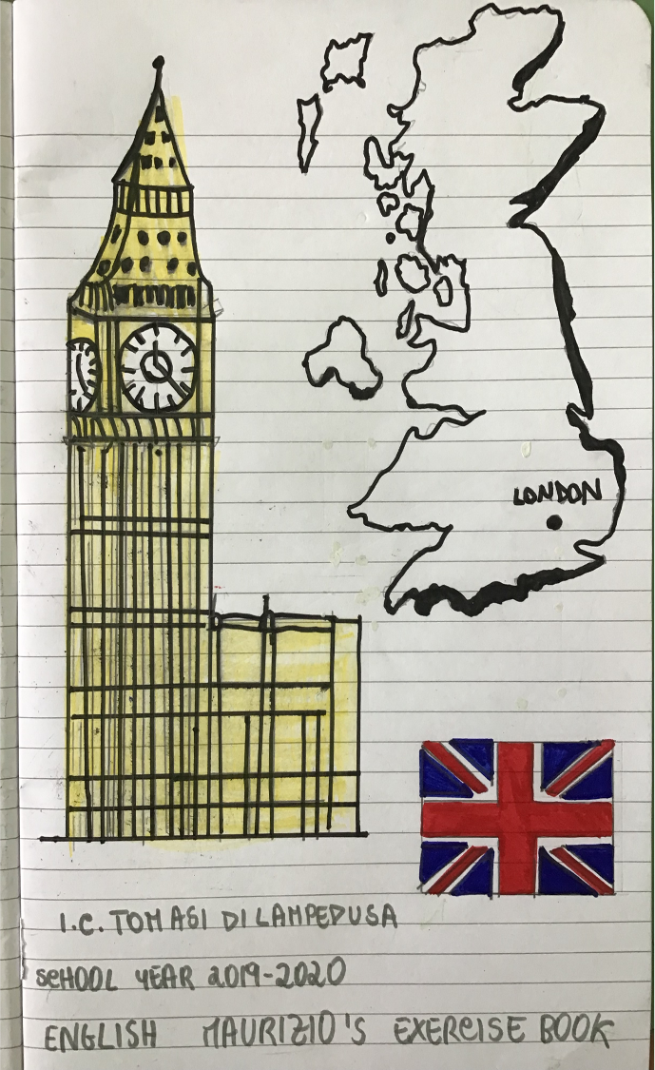
AND WE PERSONALIZE OUR EXERCISE BOOKS ☺

Slide 8
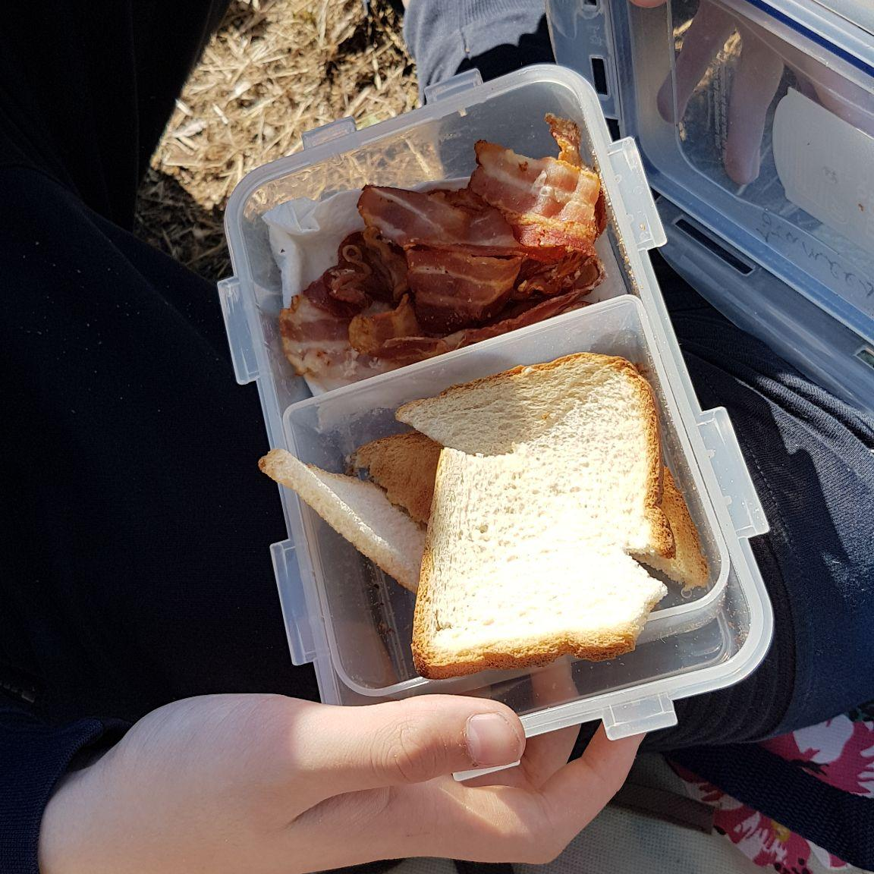
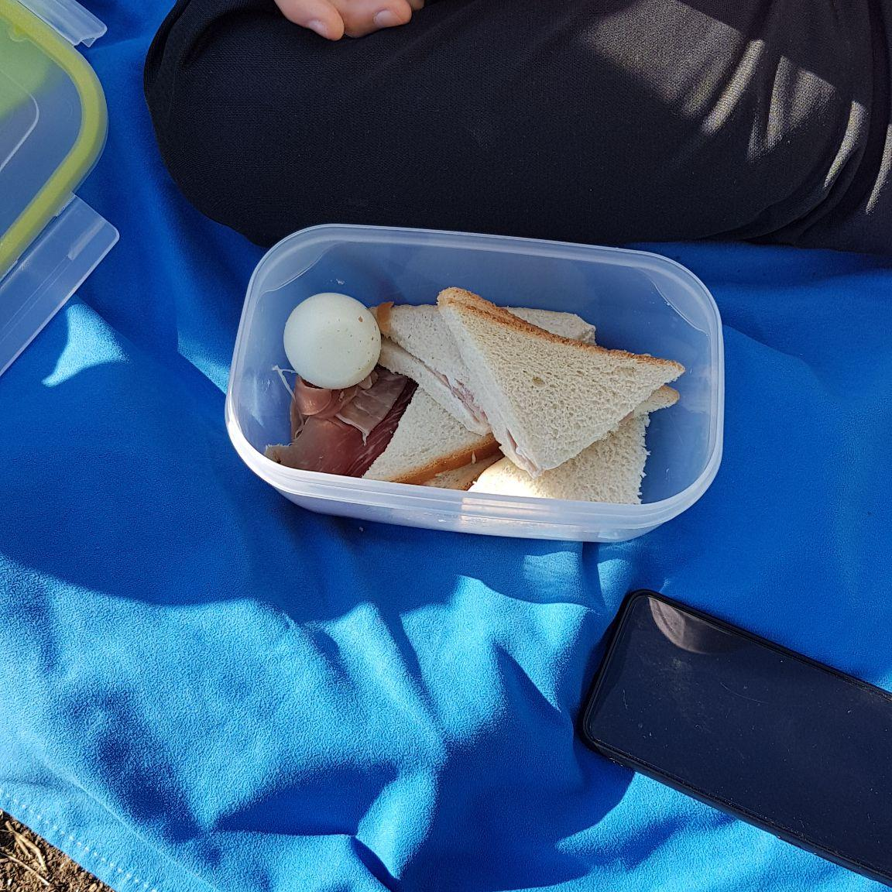
WE have funny breaks
English Breakfast
Eggs, sandwiches and sausages

Slide 9
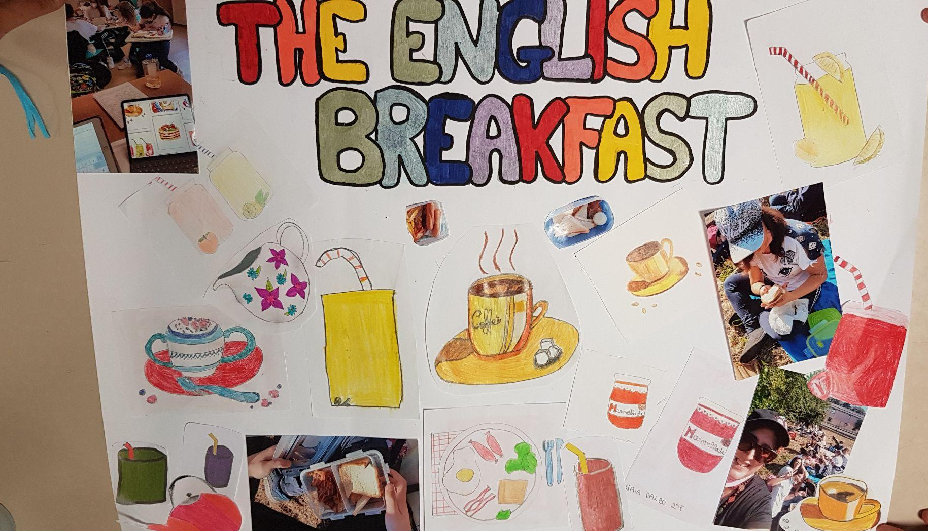

Slide 10
Come and join the Tomasi di Lampedusa Style!

